Slide 1
Importance of meat processing industry in Croatia
Dubrovnik, May 17, 2018

Slide 2
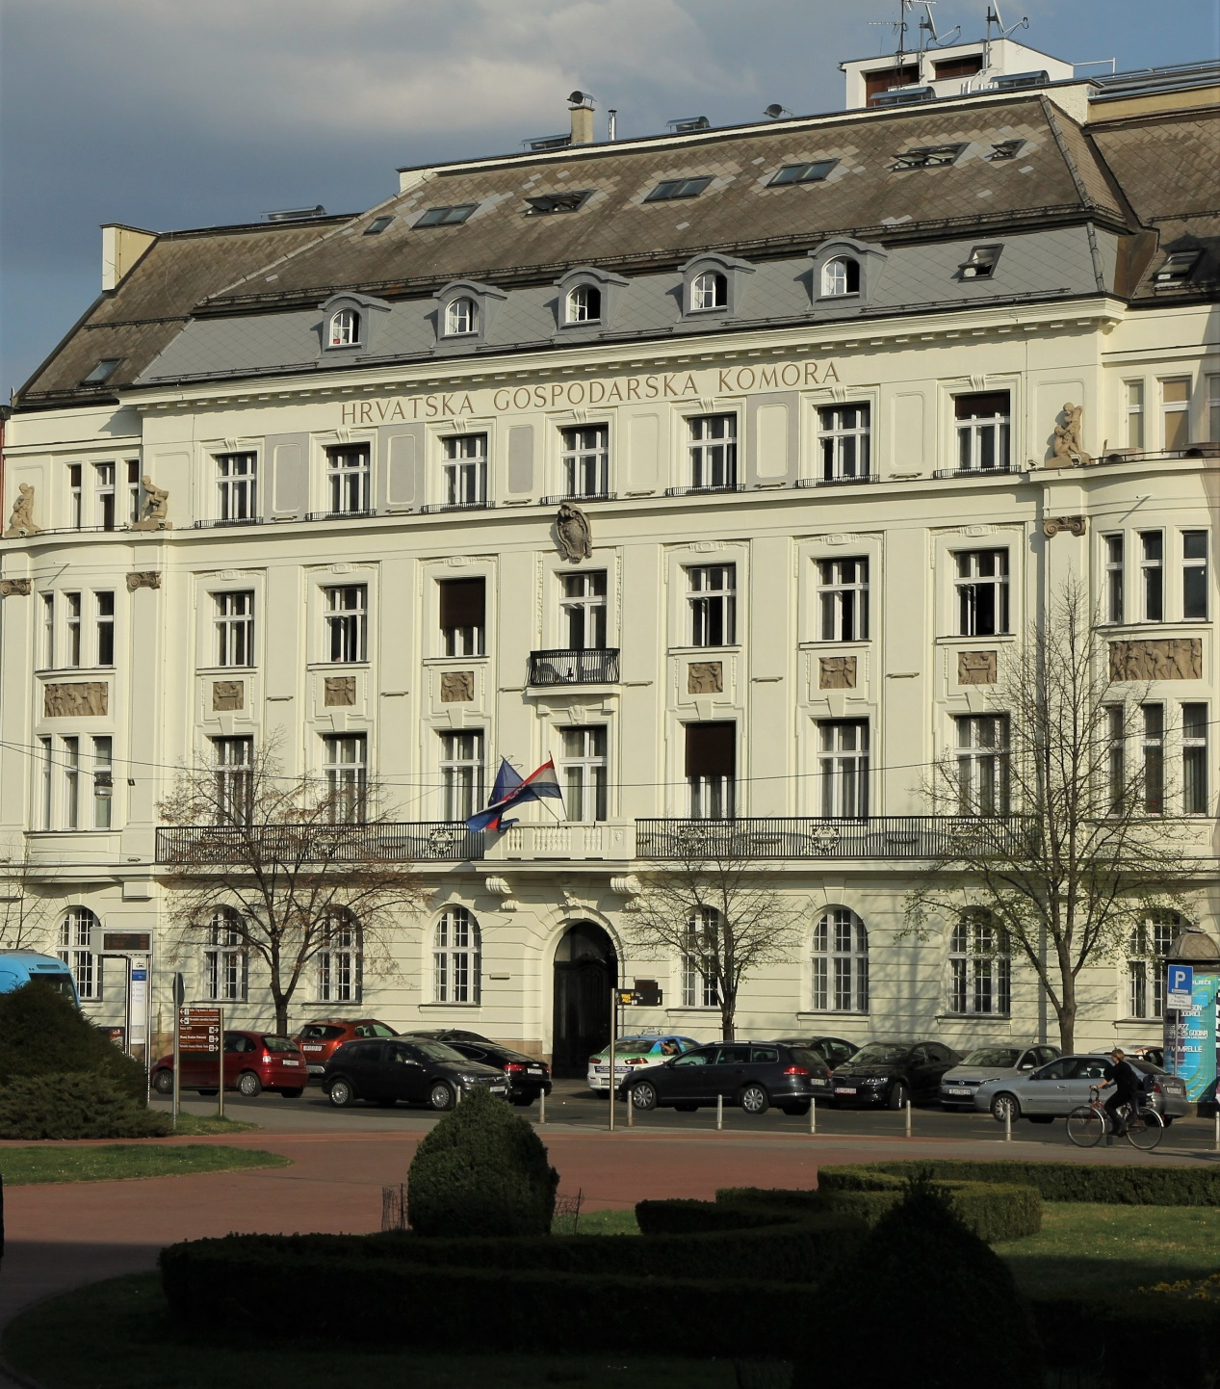
Croatian Chamber of Economy
63 PROFESSIONAL ASSOCIATIONS
MORE THAN 110,000 MEMBER COMPANIES
(all about team member)
REPRESENTITIVE OFFICES ABROAD
Easily change chart size
20 COUNTY CHAMBERS

Slide 3
Croatian Chamber of Economy
Agriculture, Food Industry and Forestry Sector 1
Supporting the work of various producers’ associations (Wine sector, Fisheries sector, Beer sector, Wood-processing sector, Slaughtering and red meat processing industry, Agricultural production and Food industry):
  Participation in creation of national policies
  Participation in creation of EU policies through membership in EU/international associations
  Realisation of promotional activities
  Organisation of informative and educational activities

Slide 4
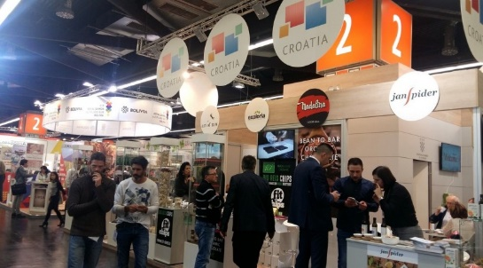




Croatian Chamber of Economy
Agriculture, Food Industry and Forestry Sector 2
Providing information on criteria and standards applicable in production, marketing and exports
Providing information on EU funds (EAFRD, EAGF, EMFF) and national agricultural support
Organisation of conferences, seminars
Collecting, processing and analysing statistical data

Slide 5
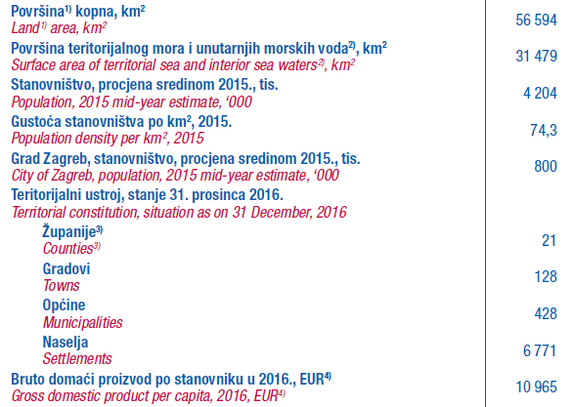
Croatia, basic information 1

Slide 6
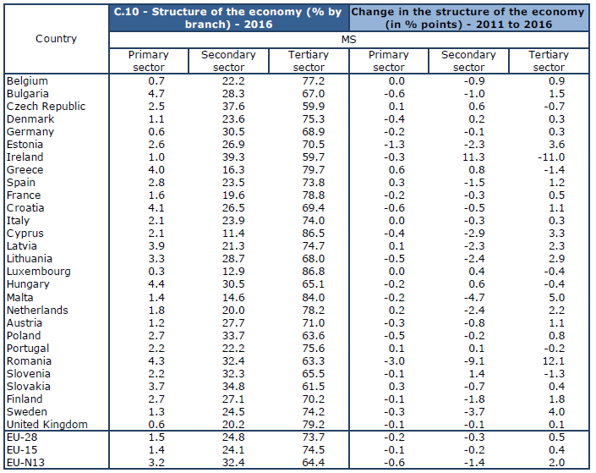
Croatia, basic information 2
% of GVA

Slide 7
Croatia in EU, agriculture

Slide 8
Croatian agriculture, output, 2017

Slide 9
Croatian Food processing industry
4,1% of total GVA
5,8% of total employment
13% in total imports and exports
most important sectors: other food products (C108), milk and dairy products (C105), meat and meat products (C101); beverages (C110); bakery products (C107)

Slide 10
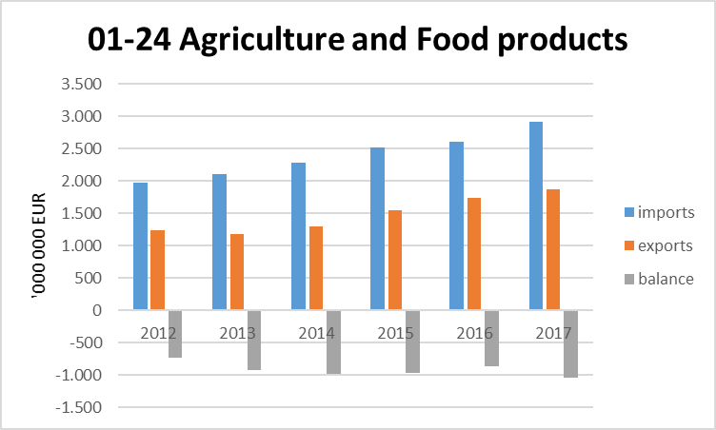
Foreign trade in agriculture and food products 1
Exports to: Slovenia, Italy, Bosnia Herzegovina, Germany, Serbia, Hungary, Austria, FYROM, Czech Republic, Montenegro
Imports from: Germany, Italy, Hungary, Slovenia, Netherlands, Poland, Austria, Spain, Serbia, France

Slide 11
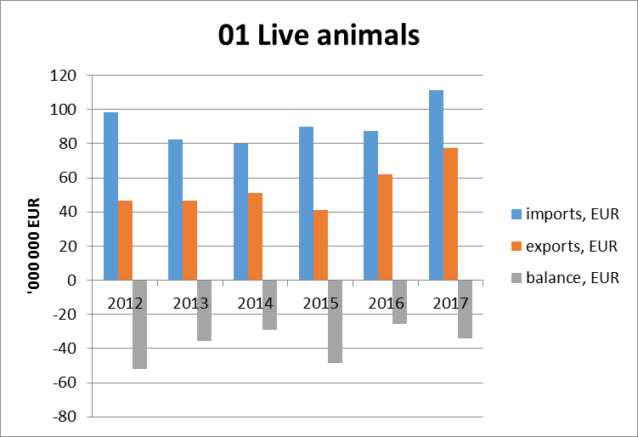
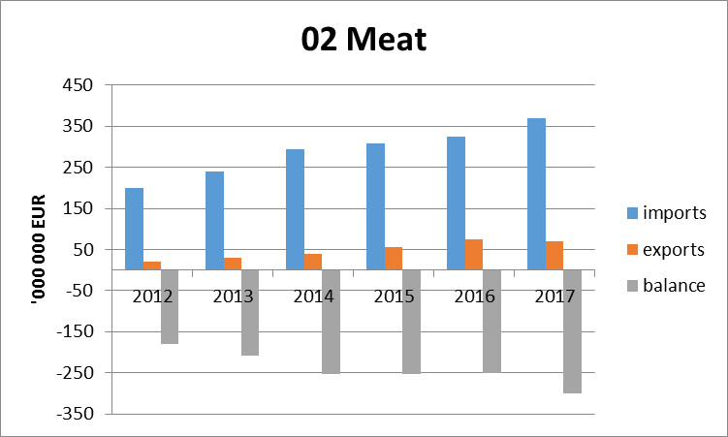
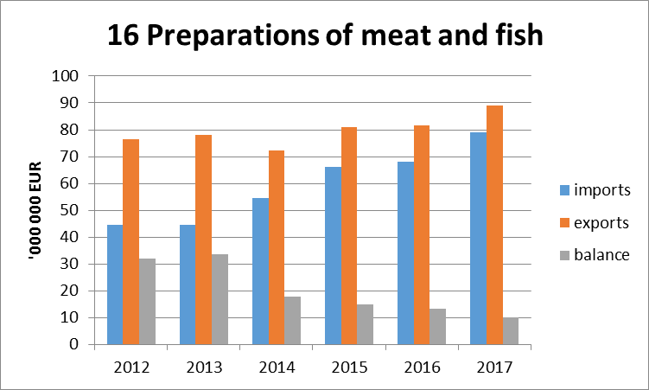
Foreign trade in agriculture and food products 2
Notes:
Uvoz 01: Rumunjska, Mađarska, Nizozemska, Slovačka, Danska
Uvoz 02: Nizozemska, Njemačka, Poljska, Španjolska, Mađarska
Uvoz 16, bez ribljih prerađevina (mesne prerađevine uvoz 67%): Slovenija, Italija, Njemačka, Mađarska, Austrija
Izvoz 01: Mađarska, Italija, Srbija, Libanon, Slovenija
Izvoz 02: Slovenija, Italija, Bosna, Austrija, Makedonija
Izvoz 16, bez ribljih prerađevina (mesne prerađevine uvoz 67%): Slovenija, Austrija, Bosna, Srbija, UK

Slide 12
Croatia in EU, livestock population
‘000 heads

Slide 13
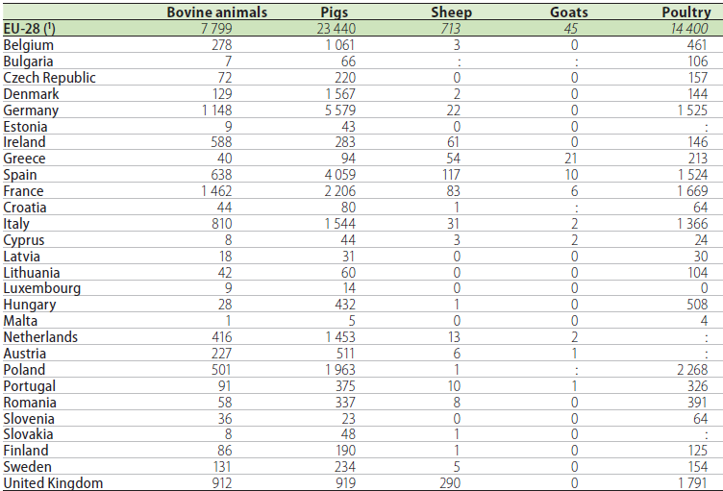
Croatia in EU, production of meat
‘000 tonnes of carcass weight

Slide 14
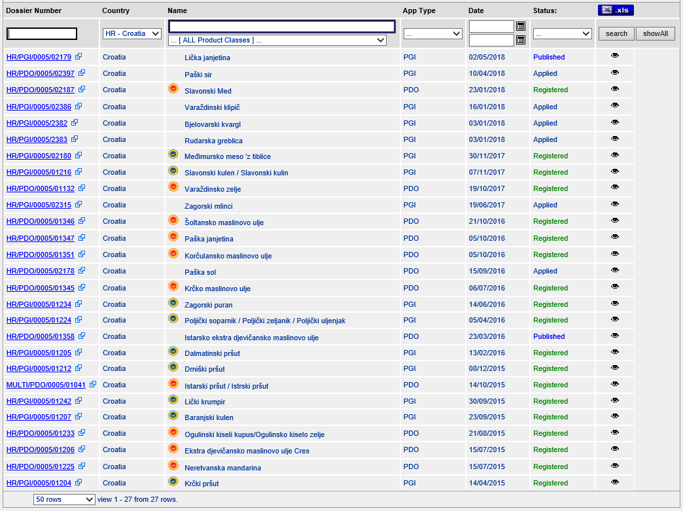


HR products in EU quality schemes

Slide 15
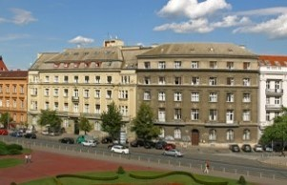
THANK YOU FOR YOUR ATTENTION
poljoprivreda@hgk.hr
zjurisic@hgk.hr
www.hgk.hr
+385 1 482 6066

