Slide 1
60th Annual General Assembly of CLITRAVI
- Commissioner Andriukaitis
Dubrovnik
17 May 2018

Slide 2
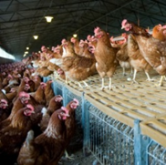
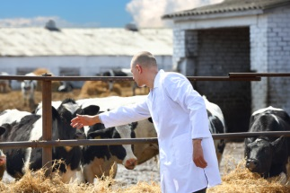
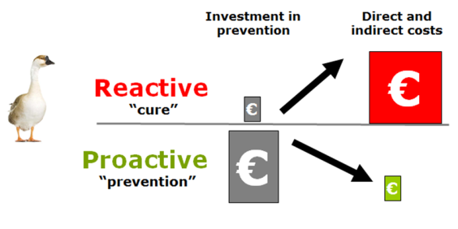
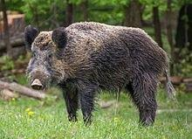


Animal Health
Transmissible animal diseases and epidemics affecting animals, people and the economy
Animal diseases
  Prevention is better than cure
NEW
§
Animal Health Law
Safe and easier trade
"One Health"
Crisis preparedness
Notes:
Slide on Animal Health and Animal Health Law

Slide 3
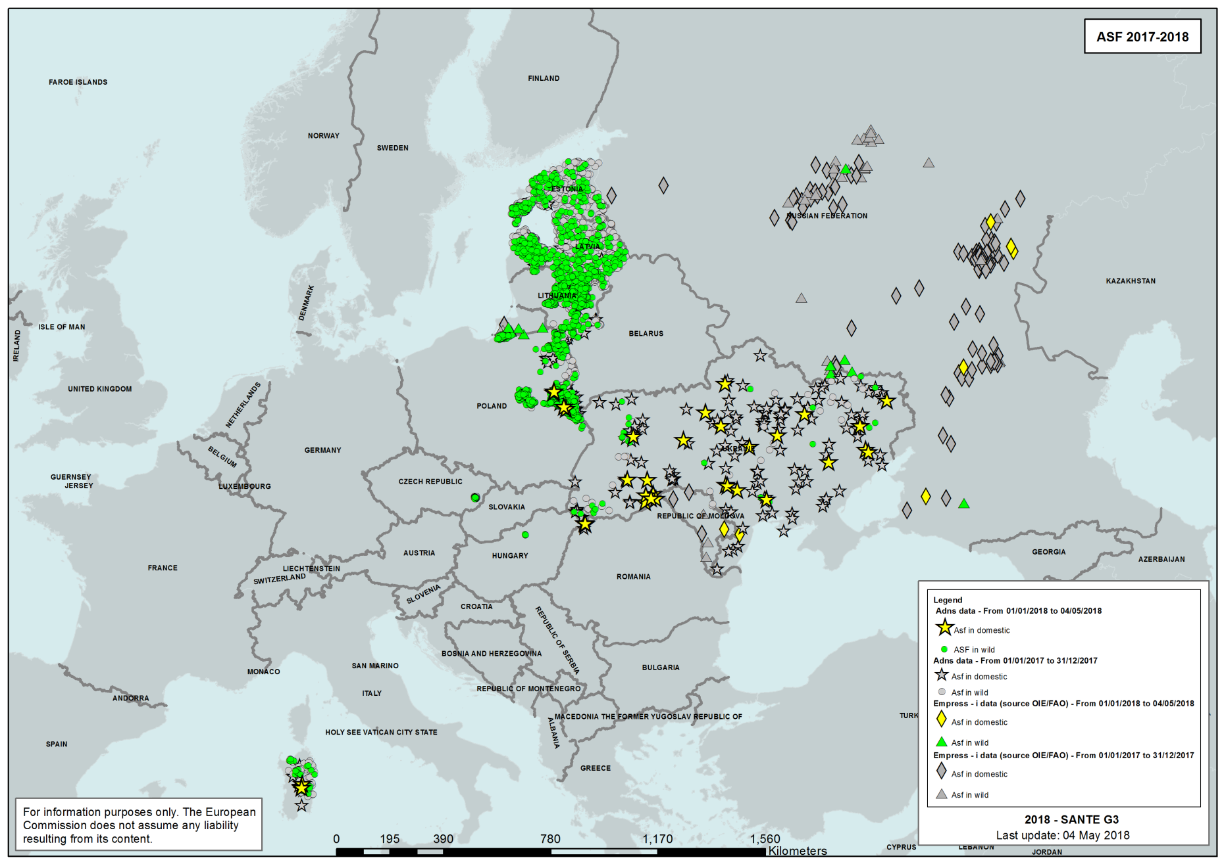
ASF large scale problem in EU neighbouring countries

Slide 4
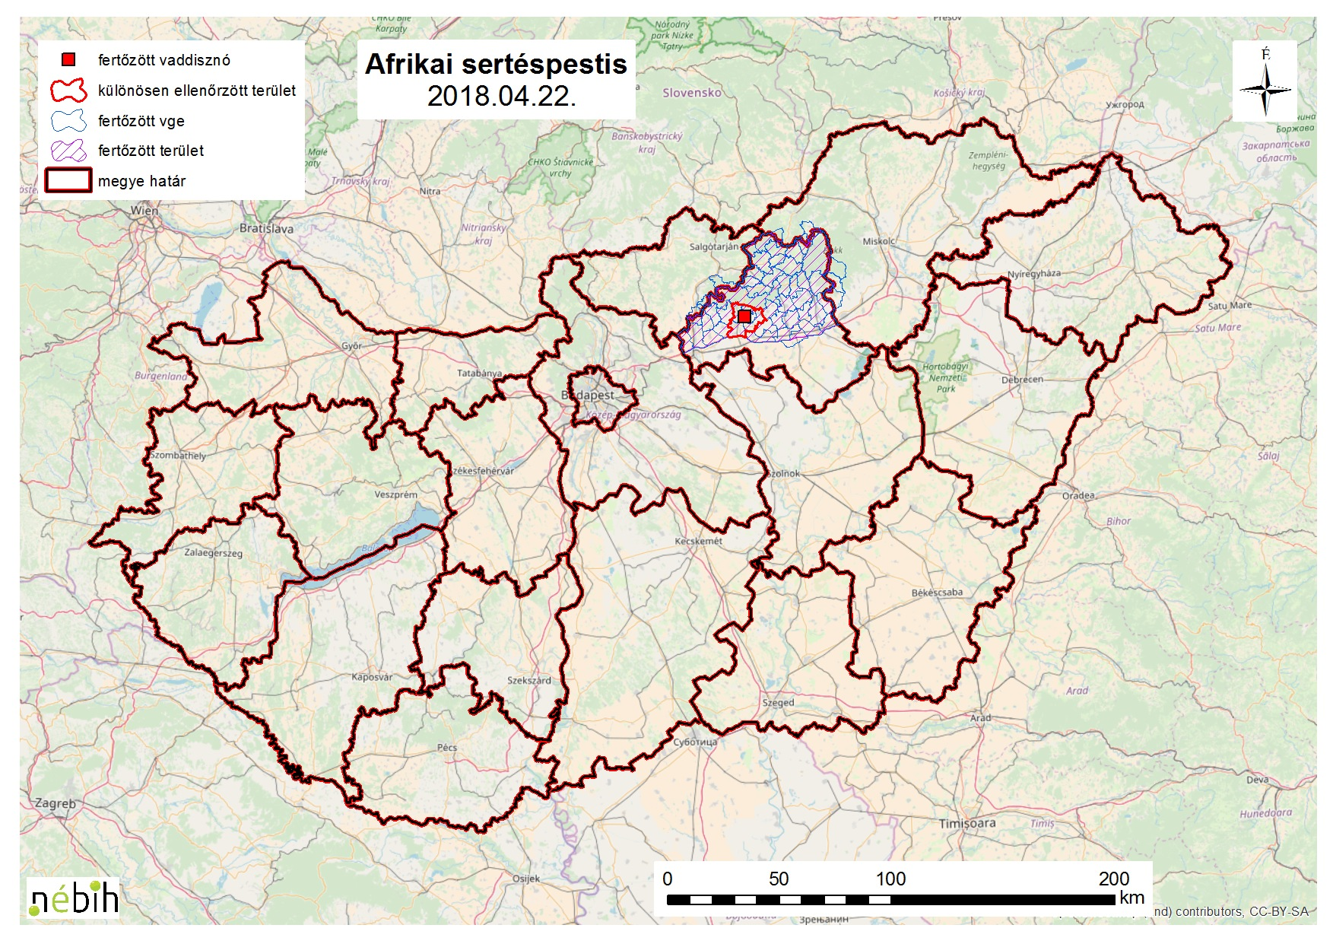
Last occurrence in wild boar in Hungary confirmed on 21 April 2018

Slide 5
Key messages
  A range of initiatives against ASF were promoted and undertaken by the Commission
  The harmonised strategy allowed for containment of ASF in relatively limited areas in the EU
  Pig industry is exposed to considerable risk of spill over from wild boar, especially in farms with low biosecurity
  Measures taken and the regionalisation put in place have limited the effects of trade bans from non-EU countries
  It is essential to combat the human factor - collaboration at borders
  ASF is a priority - the EU pig sector is one of the most economically significant farming sectors

Slide 6

EU Platform on Animal Welfare
    24 January 2017: Commission Decision establishing the Platform
  75 members, 2 meetings per year
Animal Transport sub-group already established
Welfare of pigs sub-group to be launched soon

Slide 7
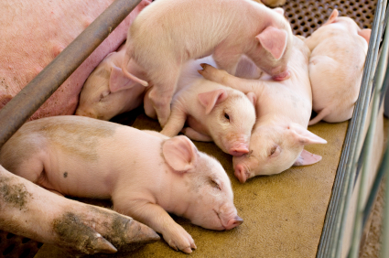
The first EU Reference Centre for Animal Welfare
    Focus on welfare of pigs
    Coordinated assistance with national centres
    Scientific and technical studies
Animal welfare indicators and assessment methods
Conducting courses for officials
Dissemination of research findings and innovations

Slide 8
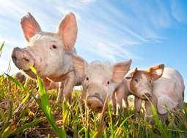
Pilot project 2018
Harmonised internal market for pigmeat obtained from pigs that have not been surgically castrated.
best practices to market meat from uncastrated or immunocastrated pigs (started in March 2018)
dissemination to transfer best practices among the relevant business operators (end of 2018 -2019)

Slide 9
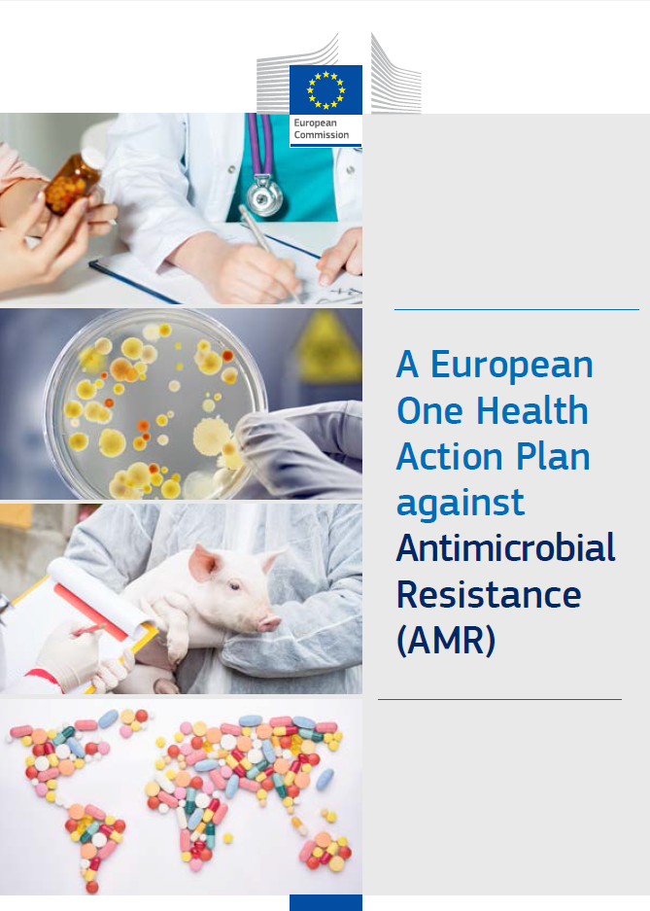
Adopted 29 June 2017

Slide 10
MAKING THE EU A BEST PRACTICE REGION ON AMR
Better evidence and awareness
Better coordination and implementation of EU rules
Better prevention and control
Better addressing the role of the environment
  A stronger partnership against AMR and better availability of antimicrobials
BOOSTING RESEARCH, DEVELOPMENT AND INNOVATION ON AMR
New economic models & incentives
Better detection and control measures
New antimicrobials, rapid diagnostic tests, vaccines & alternative therapies
AMR in the environment
SHAPING THE GLOBAL AGENDA ON AMR
Stronger EU global presence, partnering
Stronger bilateral partnership for stronger cooperation
Cooperating with developing countries
Developing a global research agenda

Slide 11
Origin indication
Sensitive topic
Consumer interest in origin labelling is strong
Origin labelling may have far-reaching impacts

Slide 12
Origin indication
Implementing Act on origin indication of the primary ingredient:
where the origin of a food is given and is different from the one of its primary ingredient, the origin of the primary ingredient shall be given or at least indicated as being different to the origin of the food

Slide 13
Origin indication
The Commission favours voluntary origin labelling, combined with the mandatory origin labelling already in place for specific foods or categories of foods
Member States may adopt national measures, subject to specific notification procedure

Slide 14
Origin indication
Implementing Act on origin indication of the primary ingredient:
clarifies how the information on the origin of the primary ingredient should be displayed on labels,
provides a list of geographical areas to which the origin indication of the primary ingredient may refer to,
harmonises the presentation of such information in order to ensure that it is easily visible and clearly legible.

Slide 15


Thank you!
Contact me:
@V_Andriukaitis facebook.com/vytenisandriukaitis

