Slide 1

60th Annual General Assembly of CLITRAVI
State Secretary
Željko Kraljičak, Phd
Ministry of Agriculture
Sheraton Dubrovnik Riviera Hotel, 17 May 2018

Slide 2

Legislation
Croatia is part of a single EU market and EU legislation is directly applicable.
The food safety system is based on several principles:
  producer responsibility (for food safety );
  traceability of food
  risk analysis system (in order to ensure that the measures applied for health protection are efficient, proportionate and clearly targeted), as well as
  precautionary principle when this is necessary (in order to ensure a high level of consumer protection if there is a risk that is still not scientifically explained).
The national legislative framework seeks to achieve conditions for creating the competitiveness of Croatian products , in same time respecting the principles of human and animal health protection, animal welfare, environmental protection, natural resources, national interests and institutional and legal framework of the EU.
The mesures from Rural Development Programme 2014 -2020 should contribute to the development of Croatian agriculture and rural areas in general by increasing the competitiveness of Croatian agriculture products and the quality of life in rural areas.

Slide 3
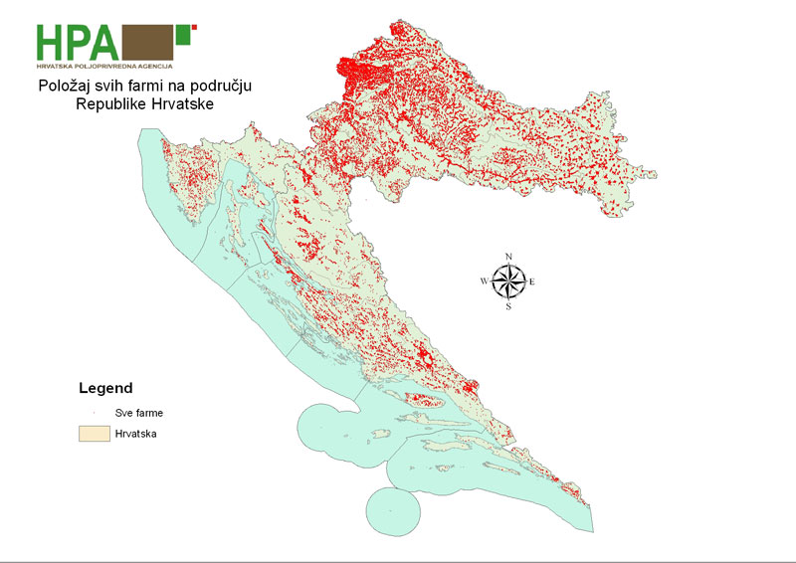
ANIMAL POPULATION IN CROATIA
Bovine animals
29 030 farms
462 531 animals
Sheep and goats
23 626 farms
762 150 animals
Pigs
94 736 holdings
(only 191 farms with more then 500 pigs)
1 377 717 animals
Equine species
5567 holdings
26061 animals
Poultry
Laying hens 3,8 mil
Broilers 5,3 mil

Slide 4
Approved establishments
Prior to Croatia's accession to the EU, Croatia met the benchmarks of Chapter 12. - Food Safety, Veterinary and Phytosanitary Policy.
All production astablishments are fully in line with EU legislation.
Approved establishments – food of animal origin
Establishments by activities |  | small capacity establishments- use flexibility measures | Total
Slaughterhouses (red meat) |  | 20 | 101
Cutting, processing |  | 57 | 234
Minced meat, meat preparations |  | 4 | 10
Slaughterhouses (poultry) |  | 4 | 35
Wild game |  |  | 20
Cold stores |  |  | 238
Eggs |  | 4 | 69
Milk |  | 10 | 62
Fish |  | 3 | 130
Live bivalve mollusks |  | 5 | 41
Snails |  |  | 2
Honey |  |  | 22
Collagen |  |  | 4
 |  | 107 | 968

Slide 5
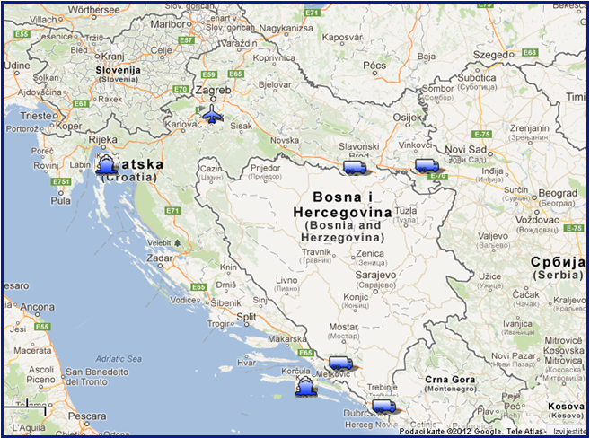
Border Veterinary Inspection Service
7 BIPs
  4 – road crossings
  2 – seaports
  1 – airport
  Location
1 BIP towards Serbia
2 BIP towards Bosnia and Herzegovina
1 BIP towards Montenegro
3 BIP ports (2 seaports, 1 airport)

Slide 6
Export and intra community trade 2017 - food of animal origin
Material | quantity
Amino acids | 24.300,00 | kg
Pet food | 41.354,60 | kg
Food / Raw Material of Animal Origin | 66.150.553,00 | kg
Food / Raw Material of Animal Origin | 52.191,80 | l
Skin of slaughtered animals | 512.810,00 | kg
Feed - by - products industry | 528.420,00 | kg
Feed materials of plant origin | 43.592.639,00 | kg
Feed mixture | 38.101.349,10 | kg
Animal fat | 84.753,40 | kg
Material K 3 | 19.200,00 | kg
Meat | 8.632.378,30 | kg
Micromineral supplements | 82.430,00 | kg
Milk | 1.196.450,20 | kg
Non-protein nitrogen compounds | 173.000,00 | kg
Other supplements | 105.898,40 | kg
Premixes | 2.752.375,00 | kg
Bee products | 147.651,40 | kg
fishery products | 27.264.399,00 | kg
Vitamin supplements | 2.550,00 | kg
Stomachs, intestines, bladders | 17.832,00 | kg
Live bivalve molluscs | 6.860,00 | kg
Data source VETI2

Slide 7
Opening new/old markets
Russia:
The Federal Veterinary and Phytosanitary Inspectorate of the Russian Federation announced its audit in the second half of 2018. In addition to the 9 existing establishments approved for export, 26 other establishments have expressed interest in exporting to Eurasian Economic Union market.
USA:
The regular assessment of compliance with the FSIS requirements regarding the inspection and understanding of the production process for the "Thermaly Processed / Commercially Sterile (TP/CS) Pork Products Inspection System" for canned products on the US export product list is in progress.
Additional documentation required for the assessment and approval of export of dried meat products and fresh pig meat.
Data report to USDA, Animal Health and Herbal Control Service (APHIS) related to Newcastle disease and Aviar Influenza as a prerequisite for the export of poultry meat products.
China:
On June 14, 2018 in Beijing, will be held12. session of the Joint Commission for Economic Cooperation between the Republic of Croatia and the People's Republic of China

Slide 8
Challenges
New – emerging diseases e.g. Lumpy skin disease and African swine fever
Lumpy skin disease – preventive vaccination in 2016 and 2017 – total costs cca 9 mil. euro.
EU co-finacing of vaccine costs 1,2 mil eur.
African swine fever – so far never confirmed in Croatia.
Prearrangement of measures – planning activities, public awareness campaign, preventive
measures etc.

Slide 9
Thank you for your attention!

