Slide 1
The Austrian Veterinary Service – structure and upcoming challenges
CLITRAVI – Congress
61st Annual General Meeting
Sheraton Grand Hotel Salzburg
Mag. Florian Fellinger

Slide 2
Content
Austria – facts and figures
  Agriculture and food industry
Structure of the authority
  Responsibilities a long the food chain
Animal Health Service

Slide 3

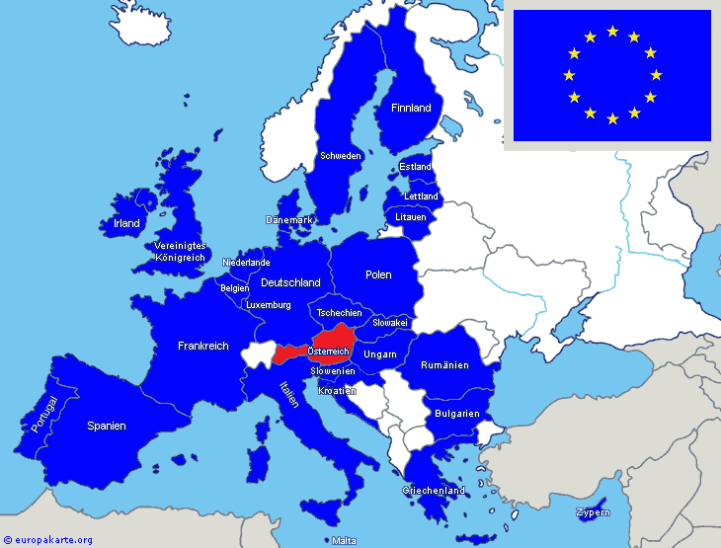
The European Union / Austria
Federal Republic
Represented by a chancellor who is the head of the federal government.
13 Ministries
Area: 83.879 km²
Population: 8.534.000
GDP 2014: 329,0 bn €
GNE gross national income 2013: 50.390 US-$
Currency: Euro (€)

Slide 4
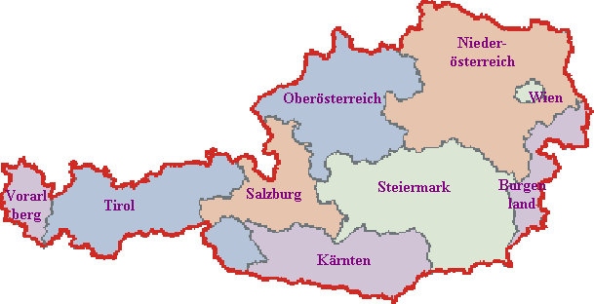
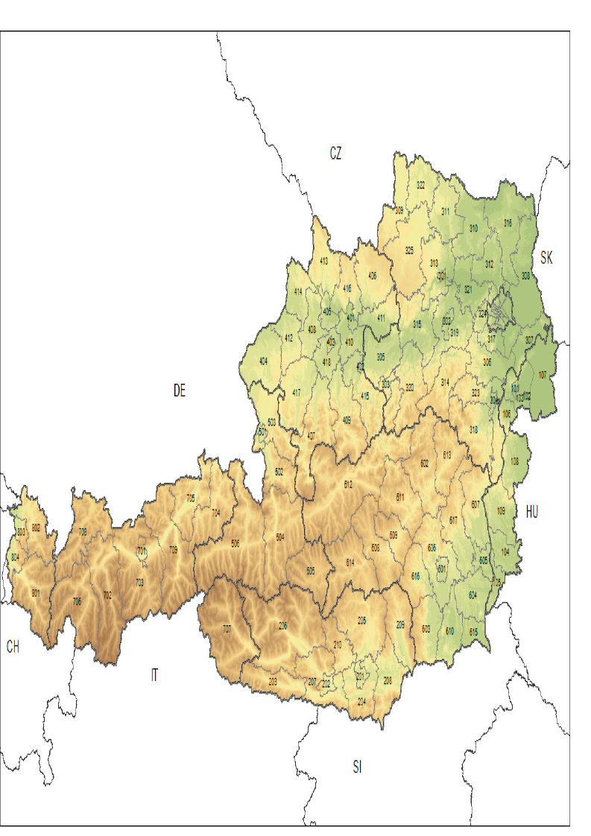
Structure of Austria
9 Federal Provinces
represented by a provincial governor
95 Districts represented
by the head of the district
and local administration

Slide 5
Number of animals and farms
Animal | Number of animals | Number of holdings | Average Animals per holding
Bovine | ~ 2.000.000 | ca. 65.200 | 31
Pig | ~ 2.900.000 | ca. 26.000 | 112
Sheep | ~ 500.000 | ca. 15.200 | 33
Goat | ~ 92.000 | ca. 10.000 | 10
Chicken | ~ 12.000.000 | ca. 50.000 | 240
Horse | ~ 72.000 | ca. 14.700 | 5
Notes:
Austria (2008)
MH 9.165.000 / 460 holdings (663 herds)
JH 2.390.000
LH 5.145.000 / 1700 holdings (>350)
ET 570.000 / 70 holdings
P 779.000 / 107 holdings

Slide 6
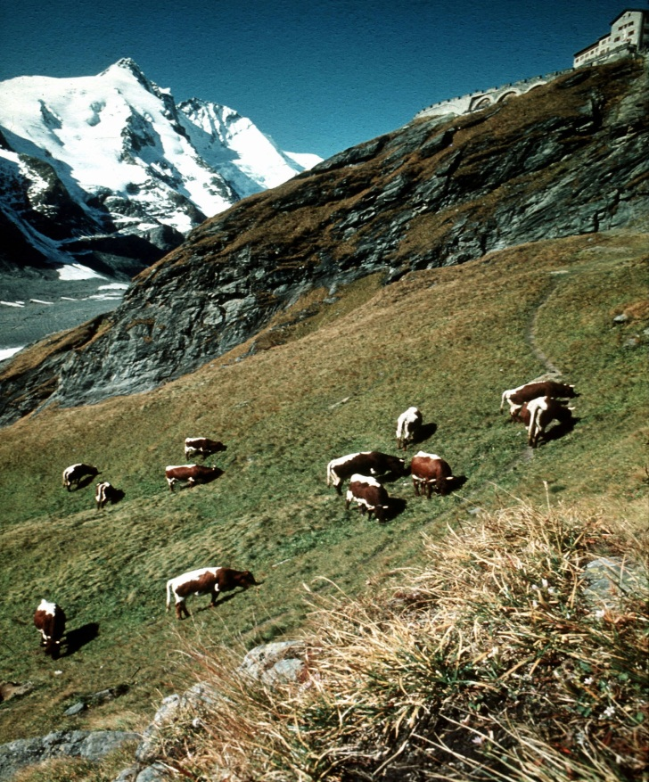
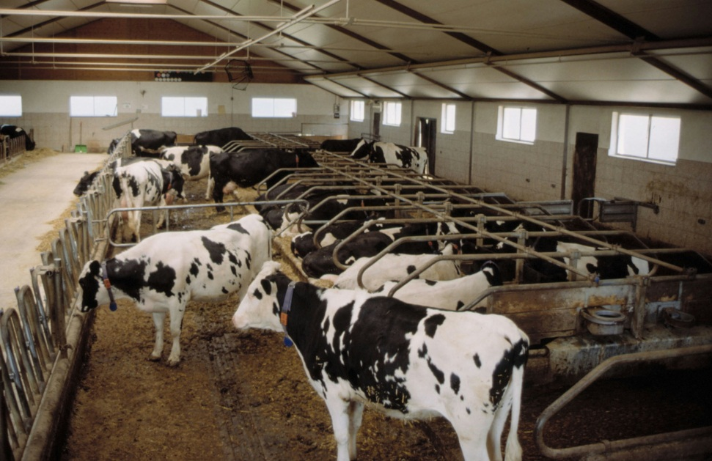
Housing in Austria
Quelle: Bmlfuw/lfz Raumberg Gumpenstein/Buchgraber
Quelle: BMLFUW

Slide 7
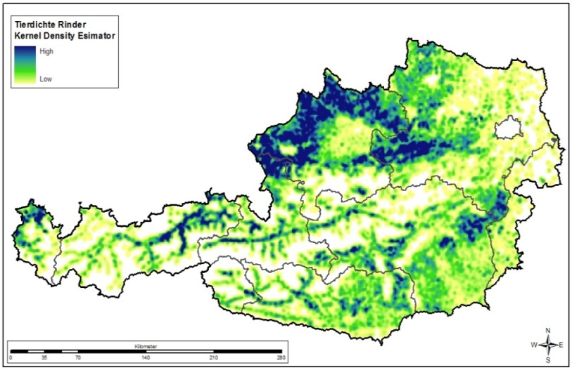
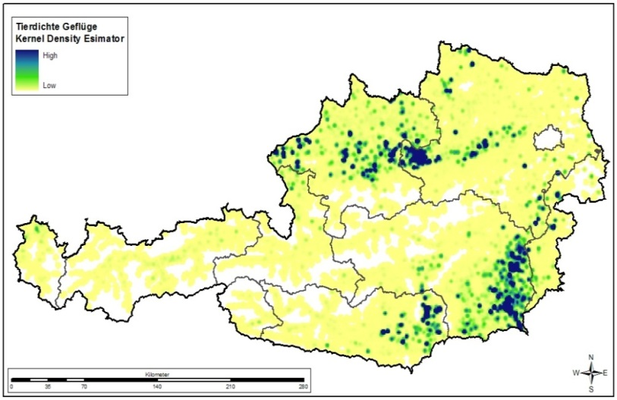
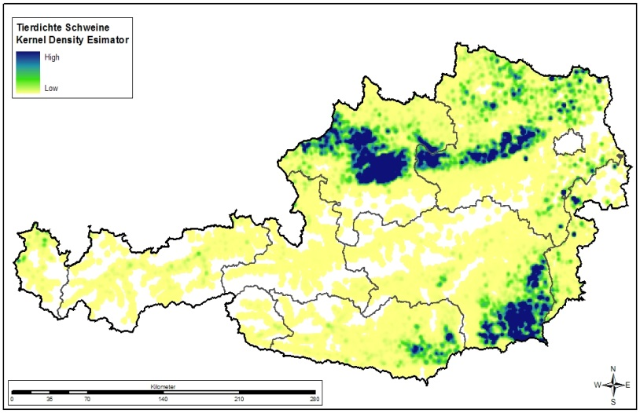
Animal density in Austria
Blue – high density
Yellow – low density
Bovines
Poultry
Pigs

Slide 8



International Memberships
Organisation International Epizootique since 1928
EUFMD since 1957
European Union since 1995

Slide 9
Freedom from disease
Austria is officially free from the following highly contagious diseases (year of last outbreak):
Foot-and-mouth disease (1981) ²
Stomatitis vesicularis¹
Swine vesicular disease (1979)
Rinderpest (1881) ²
Peste des petits ruminants^{1,2}
CBPP (1921)
Lumpy skin disease¹
Rift Valley fever¹
Sheep and goat pox (1954)
African swine fever¹
Classical swine fever (1997) ²
Newcastle disease (1997)
HP Avian influenza in poultry (1946)
African horse sickness ^{1,2}
¹ never occurred
² OIE certified

Slide 10
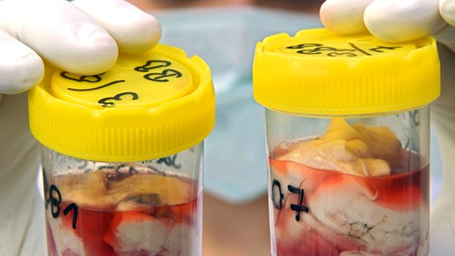

Status of BSE and Scrapie
Negligible BSE risk status
  since May 2012;
  since August 2012
Negligible risk status for classical Scrapie
  since 18 November 2014;
  Austria is the only Member State in the EU with this favourable status

Slide 11

Officially Free Status and Additional Guarantees
Officially free status:
  Bovine brucellosis – since 1999
  Enzootic bovine leucosis – since 1999
  Bovine tuberculosis (M. bovis) – since 1999
  Brucella melitensis – since 2001
Additional guarantees:
  IBR – since 1999
  Aujeszky‘s disease – since 1997

Slide 12
National Programmes
additional national surveillance and eradication programmes for:
  Bovine Virus Diarrhoe (BVDV)
  Paratuberculosis
Animal health service – programmes:
  PRRSV
  Rhinitis atrophicans

Slide 13




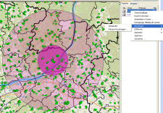
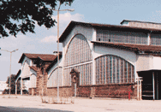
VerbraucherInformations-System (VIS) (consumer information system)
EU
Agri farm
or
x/y coordinate
Laboratory (e.g. AGES)
reporting
sample
test result
supervisory and control visit
examination and sample
as well as test result
participation in programmes and programme results
veterinary measures (e.g. ban)
ban
Supervisory and control visit
- TKZVO pig, sheep, goat
- animal health
- animal disease found in monitoring
- animal disease found by suspicion
- suspicion of presence of residues
- residue monitoring
Animal disease
- examination
- sample
- test result
- examination result
Programme
- 1782/2002 (CC)
- EU Programmes
- animal health programmes
- AHS Programme
Participation in programmes
programme results (animal health status
testing
sample
Slaughter house

Slide 14
Austrian Food industry
One of the „BIG 5“ of the Austrian industries
  More than 30 professions
  210 enterprises
  26.000 employees
  8 bn. € production volume
  5,6 bn. € export volume (more than 60 % export rate)
  ca.90 % of the enterprises are small and medium enterprises

Slide 15
Exports in Mio. Euro 2018 preliminary
Products of the Food Industry
(customs code 16-24)
 | 1995 | 2018 | V %
Total | 959 | 7.072 | 637,5
EU 27 | 732 | 4.894 | 568,5
EU 14 | 486 | 3.824 | 687,3
EU 13 | 246 | 1.070 | 334,4
Third Countries | 227 | 2.178 | 860,0
Source: Statistik Austria; FV der LMI

Slide 16
Export – third countries 2018 prelimnary
Export – third country rate in Mio. Euro
Product | total | Third country* | %
Agriculture (CC 1- 24) | 11.502 | 2.870 | 25,0
Food industry (CC 16-24) | 7.072 | 2.178 | 30,8
Other goods** | 4.351 | 1.735 | 39,9
*) Third countries excluding “EU 27”
**) agricultural goods with high value
Source: Statistik Austria; FV der LMI

Slide 17
Content
Austria – facts and figures
  Agriculture and food industry
Structure of the authority
  Responsibilities a long the food chain
Animal Health Service

Slide 18
Responsibilities along the food chain in Austria
Ministry of Sustainability and Tourism
Ministry of Labour, Social Affairs, Health and Consumer Protection
Agency for food safety and health (AGES) – laboratories, and riskassesment
BAES
The 9 federal provinces / the governor of the province
Official veterinarian (district level)
Food inspector
Consumer
First step of production: slaughterhouse, diary plant etc.
Feed
Primary production: Milk, meat, eggs, etc.
Food production
retailer
consumer
Direct sale

Slide 19
Staff in the authorities
Veterinary services
Food safety - services
Central Veterinary Services in the Ministry of Health with four departments (including crises-management)
  29 Experts and legal officers
  12 BIP-officers
9 Regional Veterinary Services in the provinces with 95 Veterinary district services
  200 official Veterinarians
  911 official Veterinarians for Meat Inspection (part time)
Central Food Safety Services in the Ministry of Health with two departments
  21 Experts and legal officers
9 Regional Food Safety Services and in the provinces
  250 Food Safety Inspectors

Slide 20
Office of Veterinary Export Certification (OVEC)
Established by the legal act - BGBl I Nr. 144/2015 December 2015
The office is a common unit of the ministry of health, the ministry of agriculture and the Agency of food safety and health
The head of the offices is
  The CVO and the deputy CVO
  For administration purposes it is the head of the Agency (AGES)

Slide 21
Tasks of the office (OVCC)
Support for the Central Veterinary Authority in the Ministry of LSHC
  Information about certificates
  Working with questionnaires
  Organisation and coordination of the Audits of third countries
  Developing checklists and directives for certification
  Coordination of the existing export databases
  Offering seminars and audits for exporting companies
  Organizing the supervision of certifying bodies
  Organizing the regular controls of the exporting food establishments according to the food safety act

Slide 22
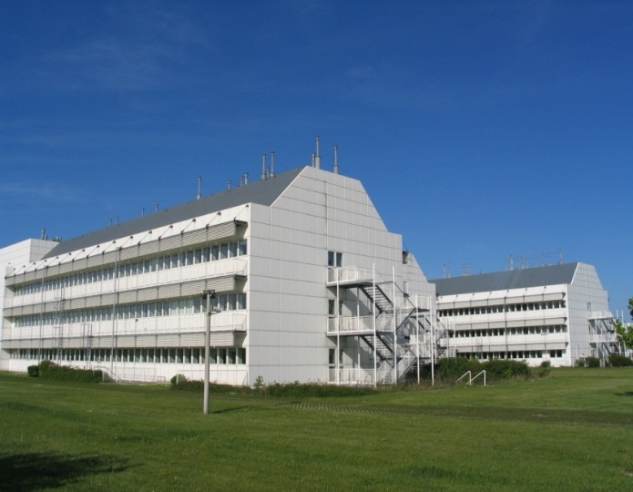
AGES - Data, Facts, Figures
Founded on June 1, 2002 Fusion of 18 Federal Agencies and Offices
Legal basis: Health and Food Safety Act (GESG)
Owner and Main Contracting Authority: Republic of Austria
1,400 Staff at its locations in:
  Vienna, Graz, Innsbruck
  Linz, Mödling and Salzburg
900,000 samples tested with
7.2 million individual analyses/year

Slide 23
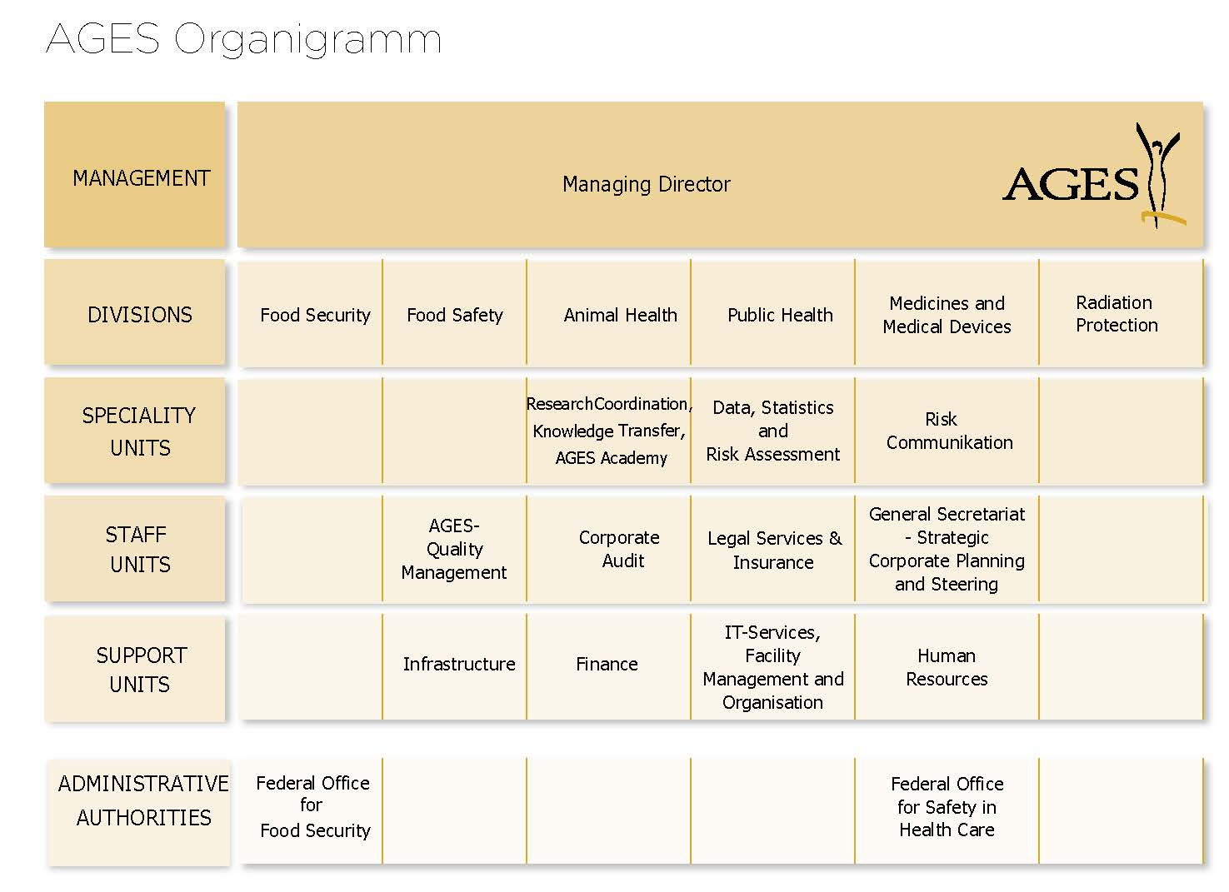
AGES Structure (Status: January 1, 2015)
¹⁾

Slide 24
Federal Offices
Federal Office for Food Safety (BAES) | Federal Office for Safety in Health Care (BASG)
Authority for 1st Instance (superior authority is the Federal Minister of Agriculture, Forestry, Environment and Water) | Authority directly subordinate to the Federal Minister of Health
Put into effect the following special administrative laws: Seed Act Propagative Material Act Plant Variety Protection Act Plant Protection Product Act Plant Protection Act Feed act Fertilizer Act Marketing Standards Act IUU Fishing Regulation (because of the Market Regulation Act) | Put into effect the following special administrative laws: Medicines Act Medicinal Products Import Act Blood Safety Act Medical Devices Act Compulsory Prescription Act Tissue Safety Act Inspections according to the Addictive Drug Act
AGES provides both federal offices with the means required to carry out their tasks (§§ 6 and 6a GESG).

Slide 25
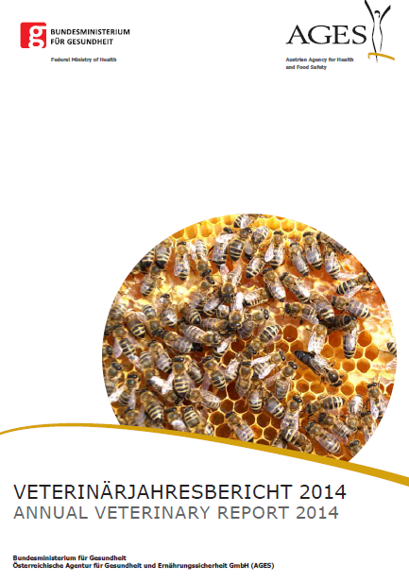
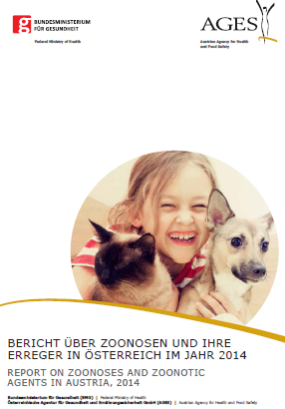
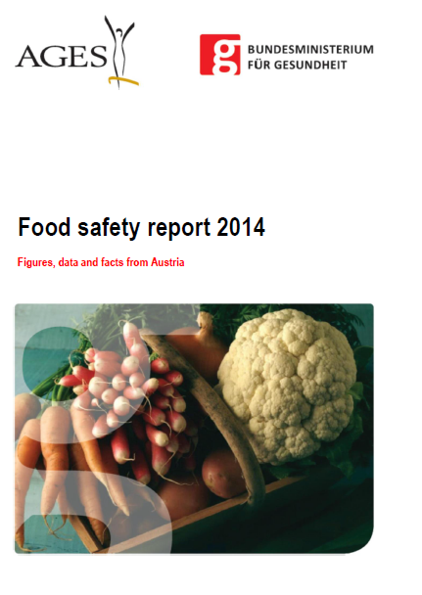
Reporting
Three reports are published every year (second half)
https://www.verbrauchergesundheit.gv.at/tiere/publikationen

Slide 26
Content
Austria – facts and figures
  Agriculture and food industry
Structure of the authority
  Responsibilities a long the food chain
Animal Health Service

Slide 27
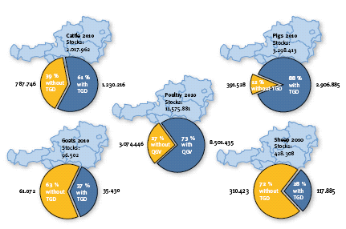
Animal Health Services (AHS or VHS)
Public Private Partnership
  Authority of federal and provincial level
  Chamber of Agriculture, Veterinarians, Consumers and Economy
The objectives
  Improvement of animal health
  Prevention of infectious diseases
  Best possible diagnosis
  Advice
  Quality assurance of foodstuffs
  Increasing the productivity
Participation rate

Slide 28
Animal Health Services (AHS or VHS)
Participation rate
Public Private Partnership
  Authority of federal and provincial level
  Chamber of Agriculture,
  Chamber of Veterinarians,
  Chamber of Consumers and
  Chamber of Economy

Slide 29
Animal Health Services (AHS)
Improvement of animal health
Screening and Prevention of diseases
Optimisation of diagnostic potential
Counselling animal keepers
Quality assurance in food production
Improvement of productivity in animal production

Slide 30
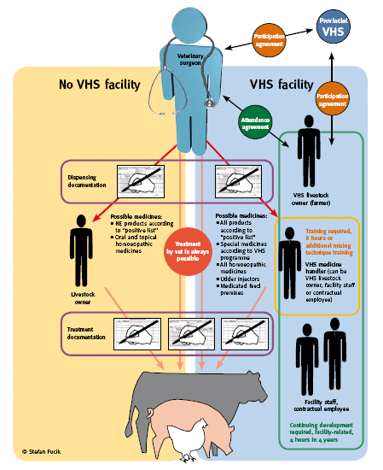
Use of veterinary medicines
Contract between livestock owner and veterinarian
Education of livestock farmer
Documentation
Regularly implemented livestock surveys
Sanctions
Animal health programmes

Slide 31
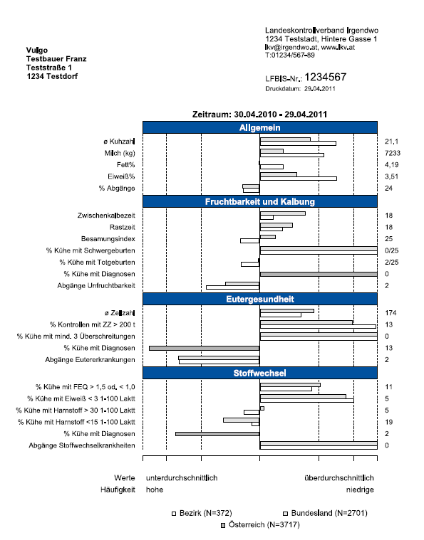
Health monitoring
Special programme for cattle within the AHS
  Prevention better than cure!!
  Preventive measures and early detection grow in importance in the cattle industry.
  Better data management is the basis for improvements in the animal health status of a herd
  Animal genetics: productivity and inherited diseases

Slide 32
Thank you
for
your attention !
Contact details:
Mag Florian Fellinger
Federal Ministry of Health
Radetzkystrasse 2 – 1030 Vienna , Austria
florian.fellinger@sozialministerium.at

