Slide 1
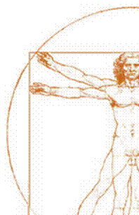
Humans, Animals & Society
A forum for a humanist ethic
CLITRAVI General Assembly
Dubrovnik, 17 May 2018
Dr Bernard VALLAT, President of FICT, France

Slide 2
Current issues
Human-animal relations
Environment
Food safety and nutrition
Zoonoses

Slide 3
Members
Groupement de Défense Sanitaire (GDS France)
Fédération Nationale de la Chasse
Société de Vénerie
Livre Officiel des Origines Félines
Société Centrale Canine
Fédération Française des Métiers de la Fourrure
Collectif des Cirques
FICT
Associate members
FNSEA
ProNatura
Eleveurs de Galop

Slide 4

Since time immemorial, humans have interacted with animals to feed and clothe themselves and work the land, as well as for entertainment and company. Most great civilisations have been built on the basis of this utilitarian but respectful interaction between humans and animals. In recent years, a new attitude towards animals has emerged, where any use of animals is seen as morally reprehensible.
Taking advantage of this heightened public sensitivity regarding animal rights, some often radical militant movements have promoted this new concept. These movements call for “animal liberation” and challenge many leisure activities (from hunting and fishing to the mere ownership of companion animals), even condemning any form of domestication and farming, which could jeopardise the agrifood and agricultural sector.
Homme Animaux & Société, the humanist ethical forum, is alive to the danger that this fundamentally antihumanist “animalist” philosophy represents, and provides a forum for exchanges and dialogue between public and private stakeholders who share the same ambition: to promote a humanist vision of human-animal relations, by bringing together all those who wish to debate a relationship that has underpinned societies for millennia.
The Forum’s scientific committee adopts public positions, giving a voice to philosophers, veterinarians, anthropologists, sociologists, economists, nutritionists, legal experts and others, to offer a considered, fair and balanced view of the role of animals in relation to humans.
The Forum promotes humanist values that ensure that humans and animals live in harmony. The human-animal relationship forms part of the history of humanity and of human life. Conversely, when all is said and done, animalism [or “animal liberation”] advocates a society with no real interaction with animals.

Slide 5


Members are committed to:
Remembering that while, in biological terms, humans are animals like any other, they have specific faculties and intellectual freedom and responsibility. We share sentiency with animals, but responsibility is specific to humans and underpins our identity;
Speaking about “animals” in general, because there is a great diversity of terrestrial and aquatic animal species and relationships cannot be identical in every case;
Promoting good practices, respecting the five freedoms for domestic animals defined by the World Organization for Animal Health: freedom from hunger, malnutrition and thirst; freedom from fear and distress; freedom from physical and thermal discomfort; freedom from pain, injury and disease; and freedom to express normal patterns of behavior;
Condemning any malevolent or illicit act, because animals are sentient beings towards which humans have obligations;
Acknowledging the central role of humans in defending biodiversity and preserving the food web;

Slide 6


Affirming the contribution of the relationship that humans have forged with animals in cultural and heritage terms;
Remembering that human beings are omnivorous and that animals contribute to their food supply and nutrition;
Taking into account economic and sociocultural data in the quest for solutions to promote animal welfare;
Recognising that in scientific research animals contribute to improving human health;
Rejecting any anthropomorphic deviation;
Advocating humanist values and tolerant discussion, remembering that humans need animals, just as many animal species need humans.

Slide 7
Official launch of the scientific committee on 7 July
Formation of the scientific committee presided by Bernard Vallat, at that time honorary Director General of the OIE, at the Maison de la Chasse.
Newsflash : Renaud Denoix de Saint Marc has agreed to succeed Bernard Vallat who has headed the FICT since 1 September 2017.
Since then the scientific committee has been expanded to include:
Bernard Denis, member of the Académie de l’Agriculture, honorary president
Francis Wolff, philosopher
Chantal Delsol, philosopher
Yannis Constantidines, philosopher
Jean-Robert Pitte, geographer, president of the Mission Française du Patrimoine et des Cultures Alimentaires (MFPCA)
Thierry Blin, sociologist at the University of Montpellier III
Éric Birlouez, food sociologist
René Laporte,economist, member of the Académie de la Viande
Jean-Denis Vigne, archaeozoologist, Director of Research at the Muséum National d’Histoire Naturelle
INRA (Alain Boissy, Jean-Louis Peyraud and Jacques Servière)
Véronique Pardo, ethnologist and OCHA official
Renaud Denoix de Saint Marc, legal expert, former member of the Constitutional Council
Charles Lagier, lawyer
Cyrille Emery, lawyer
Alexandre Le Mière, lawyer

Slide 8
Organisation of 3 college meetings
22 September: meeting of the college of legal experts headed by Renaud Denoix de Saint Marc
The status of animals
Animal rights
The status of animal rights associations
9 October: meeting of the college of philosophers headed by Francis Wolff
Human-animal relations
Presentation of contemporary utopian scenarios (post-humanism, animalism and cosmopolitanism)
19 November: meeting of the college of scientists headed by Jacques Servière (INRA) and senior politician Frédéric Descrozaille
Presentation of the INRA report on animal consciousness

Slide 9
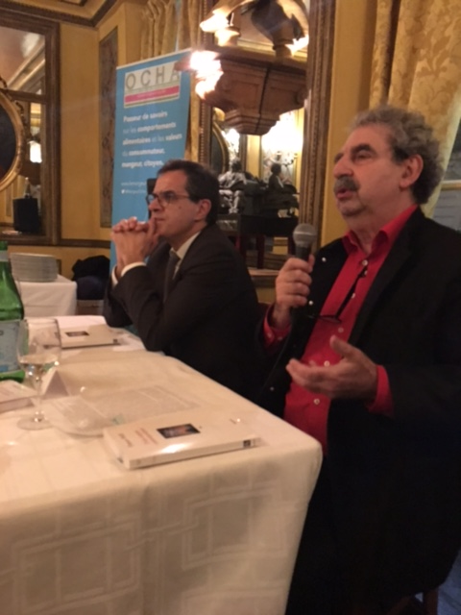
Presentation of a book by Francis Wolff
19 December at Café Procope
Presentation and dedication of the book Trois Utopies Contemporaines attended by Frédéric Descrozaille, senior politician and spokesperson of the Forum
Cocktail reception organised by OCHA
70 guests

Slide 10
Assembling language elements
Following the various meetings held in 2017 with members of the scientific committee, the Forum is now in a position to produce language elements on the different aspects of human-animal relations, thereby informing our ideological position:
Philosophical brief
Legal brief
Scientific brief
These different elements can be used to react to falsehoods and other attacks by animal rights activists.
A scientific committee forum may be unveiled during the course of the year.

Slide 11
A first proactive public announcement in the media to
kick-start the debate and promote our vision on the issue

Slide 12
Raising awareness of French people's opinions on human-animal relations
Content creation:
Today vegans represent only 0.5% of the French population and vegetarians represent around 3%. However, the damage they cause is inversely proportional.
In mid-May we will therefore present a major survey to raise awareness of how French people feel about their relationship with animals.
Obtain an honest and non-partisan picture of human-animal relations in order to build factual arguments backed by figures.
The results of this study will be presented to parliamentarians when they come to vote on the food summit (EGA) draft legislation

Slide 13
Offer the media an alternative vision of human-animal relations
A first public announcement to the media:
For many years, the media (newspapers, radio, etc.) have given a voice to vegan ideas without providing real counter-arguments.
An opinion piece in a leading daily newspaper would reposition the humanist ethic at the heart of human-animal relations.
It would be co-signed by the members of the scientific committee

Slide 14

HAS Forum site/blog: providing information
The Forum site/blog is, first and foremost, an information site. The content and structure should reflect this positioning:
It is a cross between a blog and a site, to ensure that both news (blog) and background information (site) are accessible
It provides information while presenting points of view often ignored by the press and the general public
It acts as a source of updated information supporting a humanist vision

Slide 15



HAS Forum site/blog: reinforcing the message
It provides access to the building blocks of our ideological position (language elements, graphics, etc.)
It provides analysis and criticism of animalist points of view
Where necessary it will provide warnings to the general public (threats, attacks, etc.)
It provides a link between Forum members through a newsletter module, relaying and distributing all published news, according to their interests
It relays the Twitter feed of the Forum for digital networking

Slide 16

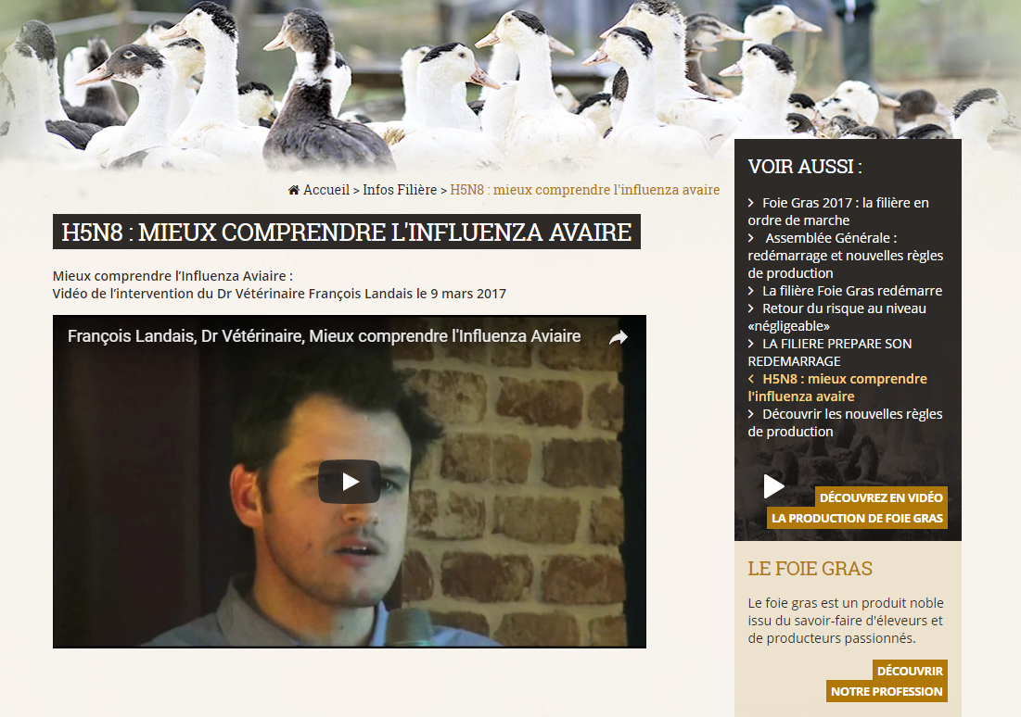

HAS Forum site/blog: defence
The site/blog is designed to provide an immediate reaction to a crisis:
It includes a defence module with pages used to state the position of the Forum immediately to its target audience. Media visibility of these pages is assured by the purchase of keywords
It includes a Tweetbox defence module offering Forum members easy access to ready-made tweets that they can retweet with one click

Slide 17
Overtures
Discussion with moderate welfare associations
The Forum could meet with moderate associations in order to open a dialogue to legitimise its position in favour of an appropriate balance in human-animal relations
GreenCross, Welfarm, CIWF, etc.
Reaching out to religious representatives
On 18 December 2018, Bernard Vallat and Matthieu Pineda were given an audience by Archbishop Silvano M. Tomasi, the Papal Nuncio responsible for the Dicastery for Promoting Integral Human Development at the Vatican, to call for a half-day to debate human-animal relations at the next Vatican conference
This would create a link with monotheistic religions that reflect human-animal relations

Slide 18
Thank you for your attention

