Slide 1
COMPANY PRESENTATION
Boris Jaranović, Marketing Director
Ines Bertinovec, Research and Development Director

Slide 2
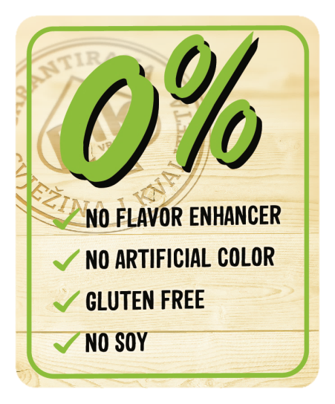
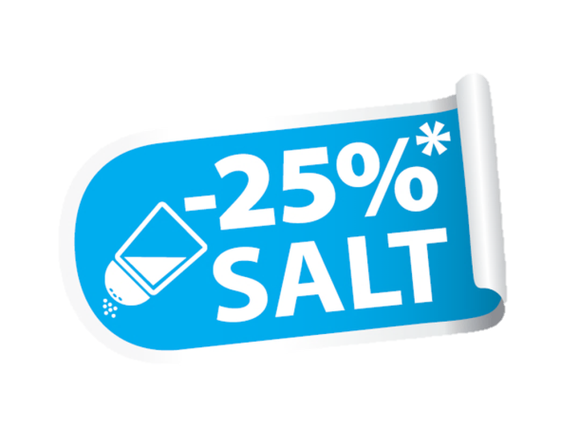

Slide 3
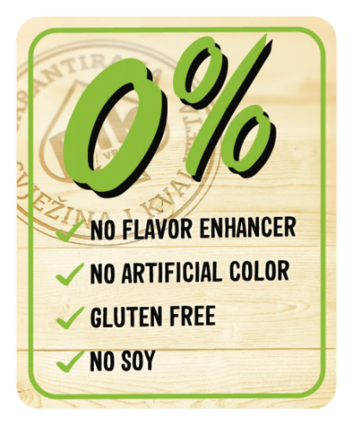
0% (2013 – 2014)
* Insight based on consumer needs and health trends
* Verified by research of Croatian consumers
* Ingredients which cause most concern – flavor enhancers, artificial colors, soy, gluten
* Intense internal product reformulation of entire PIK assortment
No flavor enhancer
No artificial color
Gluten free
No soy

Slide 4
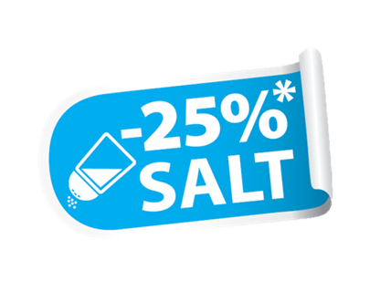
Salt reduction (2014-2015)
* Inspired by WHO and EU salt content guidelines
* Based on analysis of salt content in 230 top-selling processed meat products, covering 74-84% of Croatian market
* Overcoming challenges of maintaining flavor, product consistency and shelf life
* Result was a reduction of salt content by 25%
* Both 0% and -25% salt were innovations on the Croatian market, which were well accepted and inspired similar initiatives in other meat companies

Slide 5
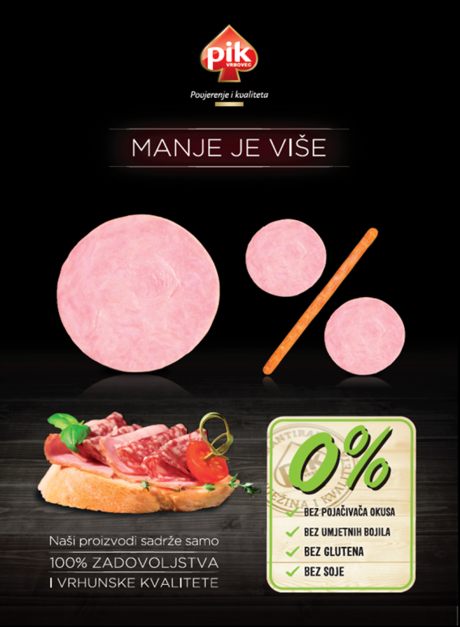
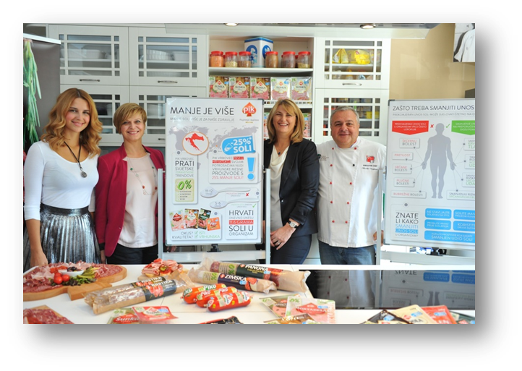
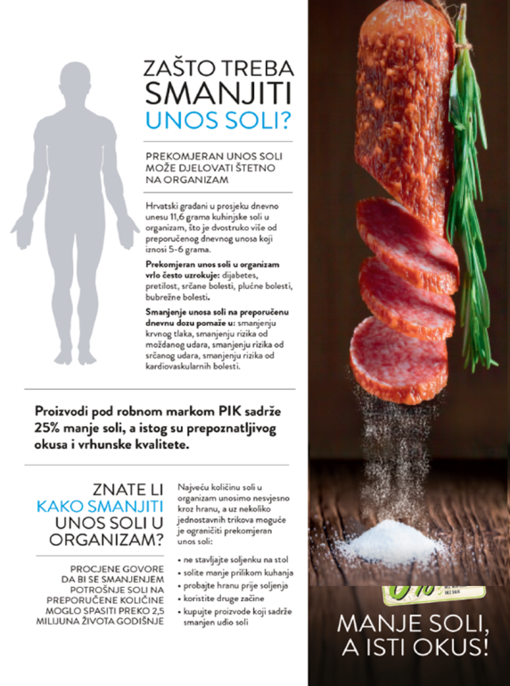
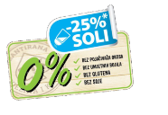
Communication (2015 – now)
* Print and online PR articles focused on raising awareness (500+ articles over 3 years)
* Collaboration with nutritionists

Slide 6
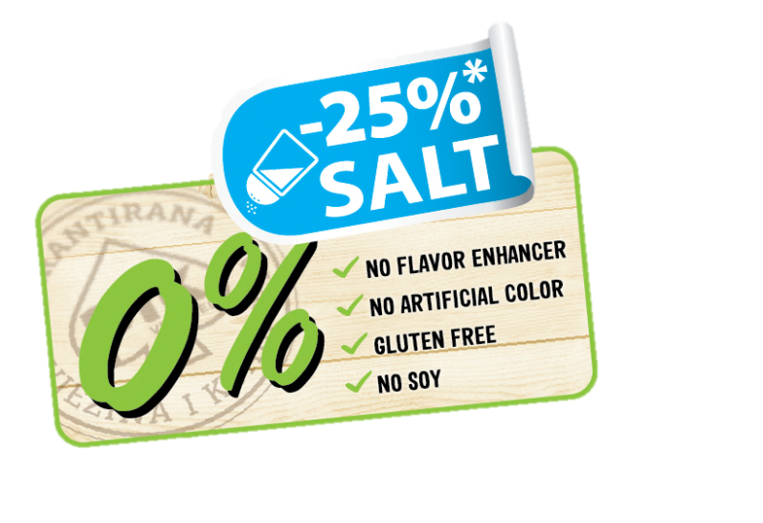
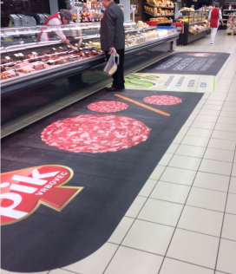
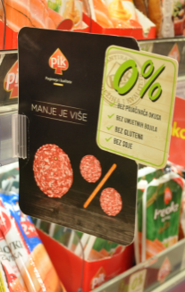
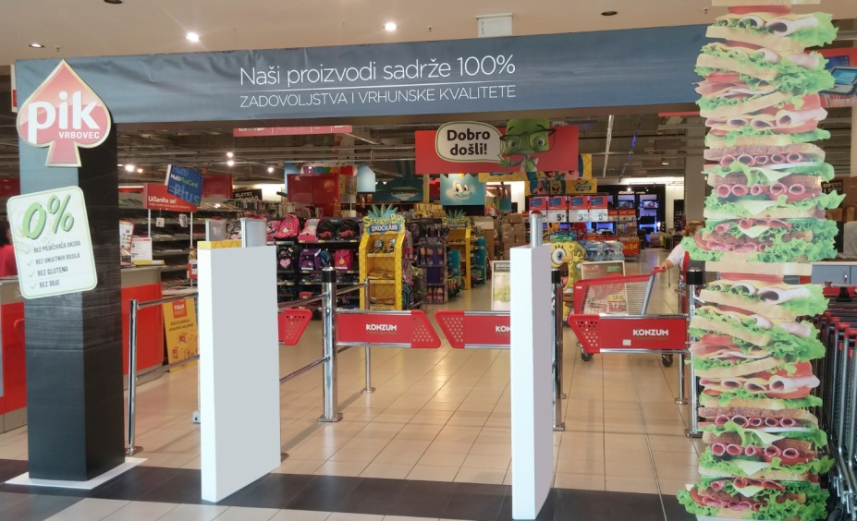
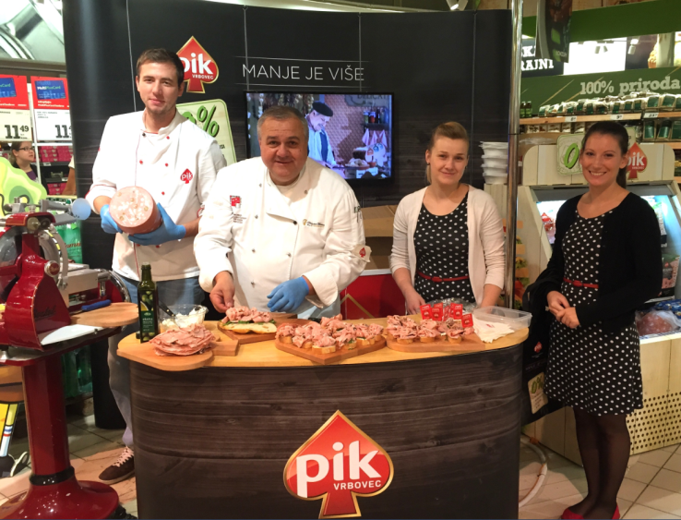
Communication (2015 – now)
* Label on products (300+ SKUs)
* TV, print, online advertising
* Point of sale merchandising, product tastings and consumer education

Slide 7
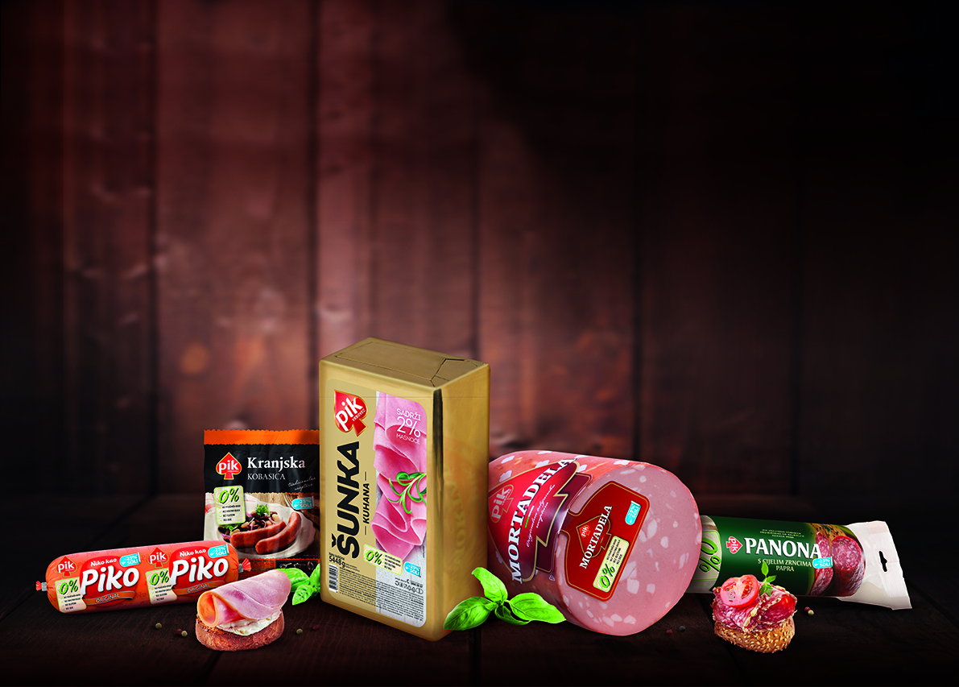
We PIK the right things
For over 80 years

