Slide 1
Market challenges for the meat sector Dr Rudolf Mögele, Deputy Director-General Directorate General for Agriculture and Rural Development, European Commission
^{#FutureofCAP}
61st General Assembly of CLITRAVI,
11 April 2019

Slide 2
Content
Production and consumption trends
Meat terms and vegetarian products
Unfair trading practices
Market transparency

Slide 3
Current market situation
Beef fragile balance (structural problems, live exports under critics, Mercosur, Brexit, US – hormone dispute)
Pigmeat promising (exports to Asia picking up due to ASF)

Slide 4
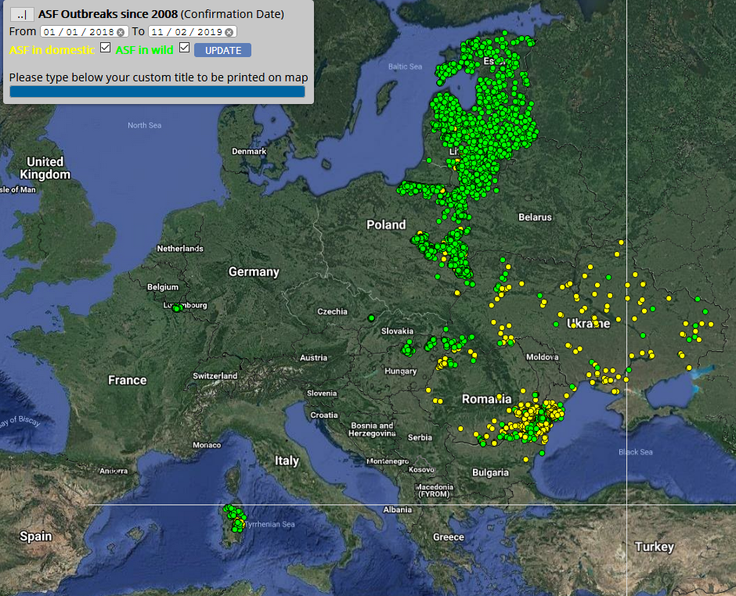
2008-2019 ASF outbreaks and cases
Outbreaks in pig holdings (in yellow) and notification of cases in wild boar (in green)

Slide 5
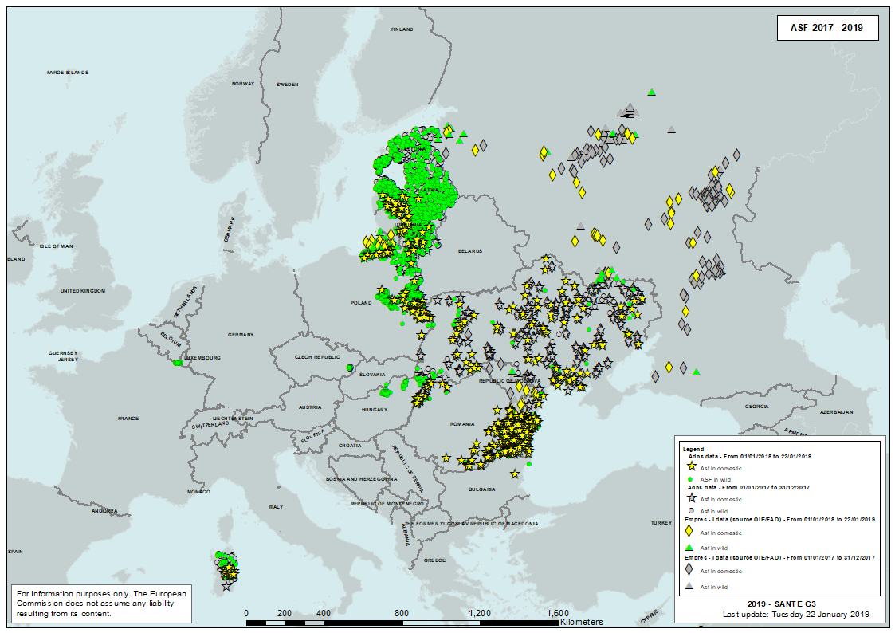
ASF in Europe 2017-2019

Slide 6
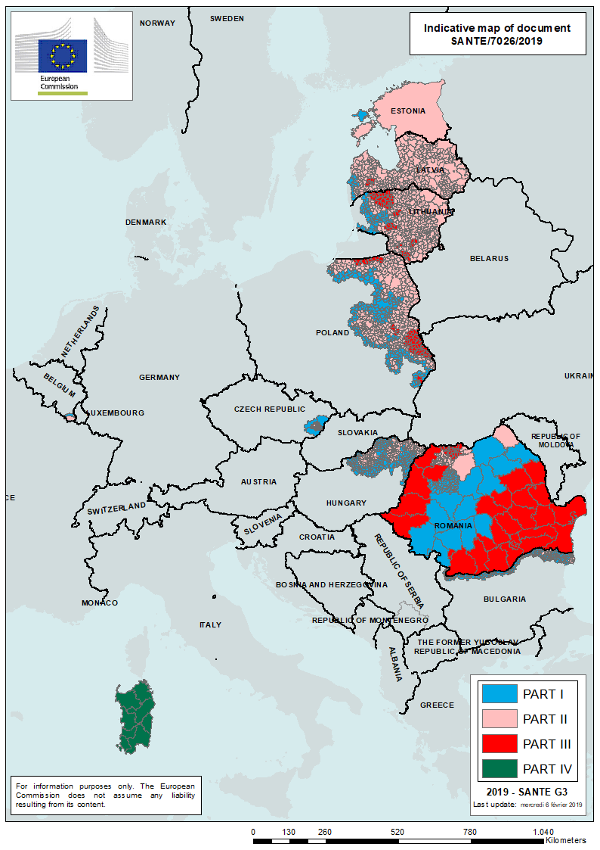
Map of EU ASF regionalisation –voted with written procedure on 11 February 2019

Slide 7
Meat: medium term challenges
Production and consumption in decline
Factors that will influence meat demand:
Societal concerns:
Health concerns
Climate change
Animal welfare
Economic situation
Change of consumption patterns and habits:
Less cooking at home, more consumption out of household (eg restaurants)
More vegetarian, vegan and « flexitarian »

Slide 8
Change of consumption patterns and habits

Slide 9
Meat: medium term challenges
Production and consumption in decline
Factors that will influence meat demand:
Societal concerns:
Health concerns
Climate change
Animal welfare
Economic situation
Change of consumption patterns and habits:
Less cooking at home, more consumption out of household (eg restaurants)
More vegetarian, vegan and « flexitarian »

Slide 10
Live animal transport
one of the main societal concerns in relation to livestock and meat production
Live animals trade (intra and extra EU) is an important part of agricultural activity and is essential for a normal functioning of the meat sector
It represents around 50% of total EU exports and around 17% of intra EU trade volume
Stakeholders and European Parliament are very concerned on animal welfare during transport and call for full implemantation and control of EU legislation
The livestock and meat sectors need to make all efforts to comply with the EU animal welfare standards in order to meet societal demands.

Slide 11
Development of Plant Proteins in EU
Main findings of Commission Report:
Plant proteins demand for food and premium feed (non-GM and organic) is growing
Consumer driven developments
Rise of the flexitarians
Health and climate reasons
Clean labelling
Notes:
In November 2018, published the Commission Report on the Development of Plant Proteins.
This report has interesting findings for your sector:
We see dynamic growth figures for the use of plant proteins for both food and premium feed.
This growth is completely consumer driven.
We see the rise of the flexitarians, and lesser extend vegetarians and vegans.
Both for health reasons and also climate concerns.
Another trend is the so-called clean labelling: Consumers are also getting more concerned about the production of their food, they don’t want E-numbers, free from allergy components. The so-called clean labelling
Did you know that most of the vegan products are bought by the flexitarians.

Slide 12
Implications for the meat sector
« Vegetarian Meat »
Dairy & meat alternatives grow 11% and 14% per year
Premium feed:
Dairy sector prospect - 100% Non-GM feed in 2025
Organic feed: 10% growth per year
Notes:
I would like to share some market developments with you
The market for dairy and meat alternatives is growing by 11 and 14% per year
You can see it when you go the supermarket.
A few years ago you would find maybe one variety, and now a broad selection of products.
Supermarkets are introducing these products under their own label as well as the major food companies are entering this market.
But closer to your sector
The demand for premium feed is growing very fast.
Take for example non-GM. The European dairy sector is expecting that they are completely non-GM by 2025.
Also non-GM poultry is growing fast in countries like Germany and Austria.
In Austria for example 100% of broilers are fed non-GM, but the share in pork sector it is currently only 8%.
Will this share also increase?
The organic animal sector is growing by 10% per year, purely on consumer demand,
Especially in western Europe.

Slide 13
Reserving terms like “sausage” or “burger” for meat products?
CMO Regulation 1308/2013 reserves certain terms for milk products (e.g. butter, cream, milk) and veal (< 8 months, 8-12 months)
Similar approach for meat products (e.g. sausage, burger, steak …)?

Slide 14
Why no EU harmonistion?
High diversity of sales denominations for meat based food (where drawing the line?)
Complex catalogue in all languages?
experience with veal and milk denominations showed challenging enforcement and constant need for clarification (up to ECJ C-422/16 “TofuTown”)
Regulation 1169/2011 – Food information to consumers – did not exist when milk terms were created – now comprehensive legal framework
Nevertheless ongoing discussion in EP on introducing meat denominations within the CAP reform (“CA 41”).

Slide 15
Food information to consumers Reg. 1169/2011
Art.7: Food information not be misleading … as to the characteristics of the food … to its nature, identity, … composition, … method of production.
In addition: Subsidiarity aspect! Several established definitions at national level (e.g. Deutsches Lebensmittelbuch)

Slide 16
Implications for the meat sector
New legislation on Unfair Trading Practices
Dairy & meat alternatives grow 11% and 14% per year
Premium feed:
Dairy sector prospect - 100% Non-GM feed in 2025
Organic feed: 10% growth per year
Notes:
I would like to share some market developments with you
The market for dairy and meat alternatives is growing by 11 and 14% per year
You can see it when you go the supermarket.
A few years ago you would find maybe one variety, and now a broad selection of products.
Supermarkets are introducing these products under their own label as well as the major food companies are entering this market.
But closer to your sector
The demand for premium feed is growing very fast.
Take for example non-GM. The European dairy sector is expecting that they are completely non-GM by 2025.
Also non-GM poultry is growing fast in countries like Germany and Austria.
In Austria for example 100% of broilers are fed non-GM, but the share in pork sector it is currently only 8%.
Will this share also increase?
The organic animal sector is growing by 10% per year, purely on consumer demand,
Especially in western Europe.

Slide 17
Key elements
Legal basis: Article 43 TFEU
The Directive:
protects weaker suppliers against stronger buyers (B2B) against UTPs occurring in the food supply chain
links to agricultural and food products
follows minimum harmonisation approach (MS can go farther)
protects against 16 specific unfair trading practices
provides for minimum enforcement power
stipulates coordination between MS authorities

Slide 18
Protecting the weak against the strong
Turnover calculation >> Commission SME Recommendation
Foreign suppliers / foreign buyers (territorial competence)

Slide 19
Distinction between black and grey UTPs
The distinction between “black” and “grey” UTPs in the Commission’s proposal has been retained.
Black UTPs. Prohibited, whatever the circumstances.
Grey UTPs. Prohibited, if the parties do not clearly and unambiguously agree beforehand.

Slide 20
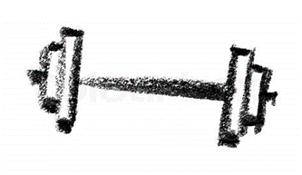
Powers of the enforcement and cooperation
MS have to designate an enforcement authority
Can be an existing authority
Vested with powers:
to act upon a complaint or act ex officio
to investigate
to terminate an infringement
to levy fines and impose other penalties
to publish decisions
Cooperation
MS to ensure that the enforcement authorities cooperate effectively with each other and with the Commission
And to provide each other mutual assistance in cases with cross-border dimension
Regular meetings, facilitated by the Commission
Website, internally for enforcement authorities and public website with links to designated authorities and information about acts of transposition

Slide 21
Next steps
Endorsement by the co-legislators
Still during this legislative mandate (signature by co-legislators on 17.04)
Publication in the Official Journal (+/- 5 days from signature)
Entry into force (1 day after publication)
24 months after entry into force: transposition
30 months after entry into force: application of rules

Slide 22
Implications for the meat sector
Market transparency
Dairy & meat alternatives grow 11% and 14% per year
Premium feed:
Dairy sector prospect - 100% Non-GM feed in 2025
Organic feed: 10% growth per year
Notes:
I would like to share some market developments with you
The market for dairy and meat alternatives is growing by 11 and 14% per year
You can see it when you go the supermarket.
A few years ago you would find maybe one variety, and now a broad selection of products.
Supermarkets are introducing these products under their own label as well as the major food companies are entering this market.
But closer to your sector
The demand for premium feed is growing very fast.
Take for example non-GM. The European dairy sector is expecting that they are completely non-GM by 2025.
Also non-GM poultry is growing fast in countries like Germany and Austria.
In Austria for example 100% of broilers are fed non-GM, but the share in pork sector it is currently only 8%.
Will this share also increase?
The organic animal sector is growing by 10% per year, purely on consumer demand,
Especially in western Europe.

Slide 23
Definition of market transparency
“the availability of relevant market information (e.g. concerning prices, weather, production, trade, consumption and stocks) for all market participants”
AMTF, November 2016

Slide 24
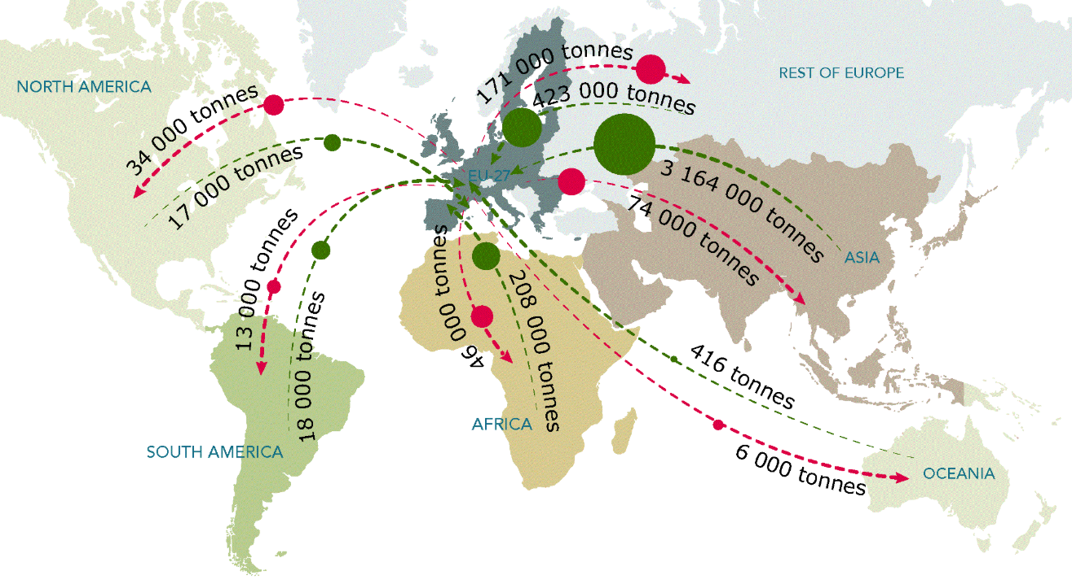
Economic context
Market information is of increasing importance:
Increasing market orientation of the agri-food sector
Increasing levels of market concentration at the processing and retail stages
Changing consumer demand patterns
Increasing integration into global markets

Slide 25
Political context
European Parliament resolution, 7 June 2016:
Calls for increased transparency… within the supply chain and for the strengthening of bodies and market information tools… (https://europa.eu/!GG99Wn)
Council conclusions, 12 December 2016:
Calls on the Commission to address… the issue of lack of transparency and information asymmetry in all levels of the food supply chain… (https://europa.eu/!Yc83tK)
Joint statement, 12 March 2019:
… the transparency of agricultural and food markets is a key element of a well-functioning agricultural and food supply chain… The Commission is encouraged to continue its ongoing work… (https://europa.eu/!yT36XH)

Slide 26
Existing legal framework
CMO Regulation (1308/2013), Art. 223, Communication requirements:
For the purposes of…
monitoring, analysing and managing the market…
ensuring market transparency,
ensuring the proper functioning of CAP measures…
A delegated act (2017/1183) and an implementing act (2017/1185) supplement the CMO Regulation, esp.:
What prices and quantities should be reported with which frequency? (Annex I-III of 2017/1185)

Slide 27
Benefits of market transparency
Operators in the food supply chain:
Increased production efficiency
Improved risk management
Increased trust
Public authorities
Reduced need for public intervention
More informed public policy and improved enforcement
Better preparation for and response to crises
Multiplier effects
Benefits for consumers, researchers, environment

Slide 28
Conclusions
There is support to extend the collection and publication of market data as long as:
system not too costly
publication raises no new competition concerns
reporting targeted on key products only
data are of good quality and published in a timely manner
information contributes to a better understanding of structural issues in the chain

Slide 29
In summary
Complex situation in the years to come, in a context of declining demand for meat and meat products for different reasons.
The sector would need to be proactive to adapt to demands from a changing society
Next years are key for the reputation of the sector: Cooperation in the implementation of UTPs EU legislation and in the Transparency initiative are a must.

